Slide 1

Design and Development of Wireless ECG Device
Heritage Institute Of Institute Of Technology
GROUP NO.: 43
MEMBERS:
Aniket Sarkar Roll No. 2152022
Ritwik Saha Roll No. 2152209
Swastika Banerjee Roll No. 2152110
Mousumi Sinha Roll No. 2152254
Project Supervisor: Prof. Pratima Shaw

Slide 2
Abstract
In this project we aim to develop a simple and cost effective wireless ECG system using ESP32, AD8232 ECG sensor and Ubidots cloud platform.
Electrocardiography is the process of recording heart signals via leads attached to the patient’s body. It provides a visual representation of the electrical activity of the heart.
The ECG Graph can be analysed to detect any anomalies to diagnose underlying heart conditions.

Slide 3
Introduction
The mortality rate due to CVD(CARDIOVASCULAR DISEASE) can be significantly reduced through an electrocardiogram (ECG) test.
Therefore, portable and wearable ECG monitoring devices have been developed to promptly evaluate heart conditions in a rapid and convenient manner.

Slide 4
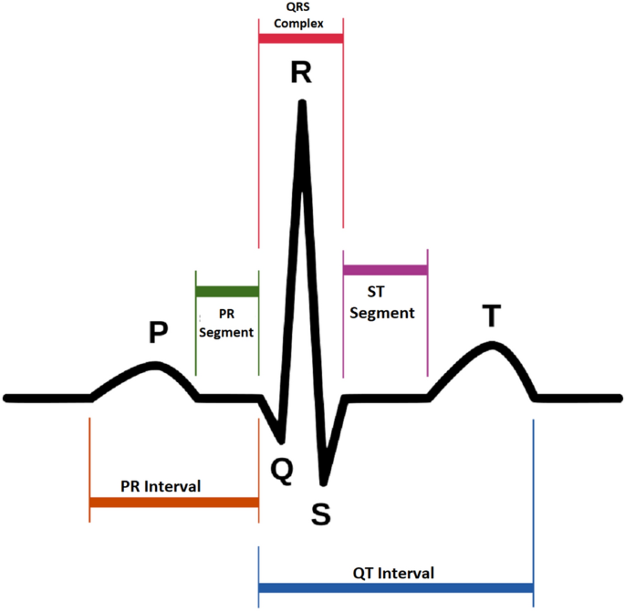
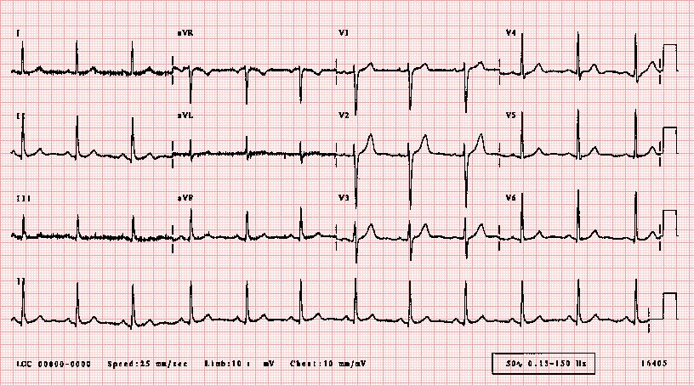
ECG Graph
P wave: Represents atrial contraction (depolarization), showing the start of the heartbeat.
QRS complex: Indicates ventricular contraction, the main pumping action of the heart.
T wave: Shows ventricular relaxation (repolarization) as the heart resets for the next beat.

Slide 5
Implementation using Arduino Uno(Wired Version)
For the first half of the project, we implement our ECG Device using Arduino uno and AD8232 ECG sensor to test the capabilities of our components and verify the output on an oscilloscope or computer screen.

Slide 6
Components
Arduino Uno(1)
AD8232 ECG Sensor(1)
ECG Electrodes(3)
Type B Cable(1)
Connecting Wires(More than one)
Breadboard(1)
Arduino IDE

Slide 7
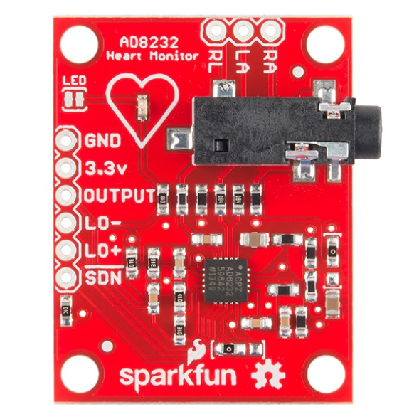
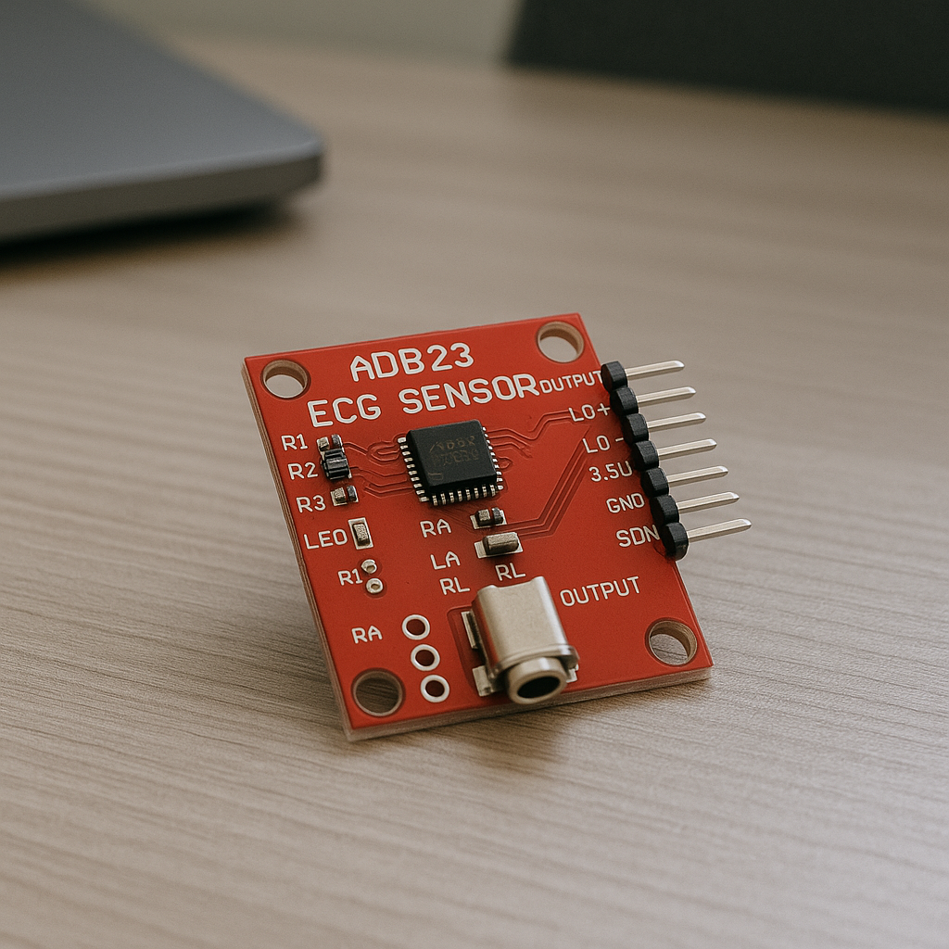
Components:
AD8232 ECG Sensor
PINS
Power Input Pins (3.3, GND)
Electrode pad connector pins (RA, LA, RL, 3.5 mm female jack)
Data output pin (Output)
Leads off detection output pins(LO-, LO+)
Shutdown control pin(~SND)
LED

Slide 8
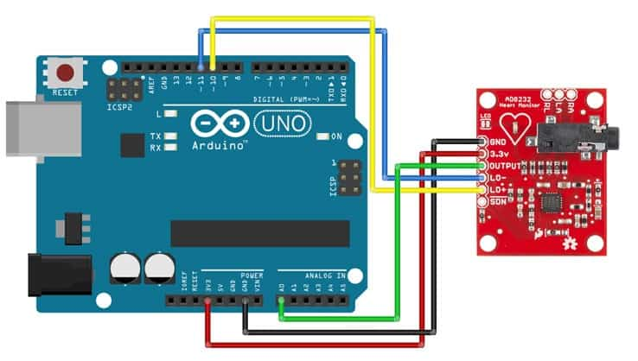
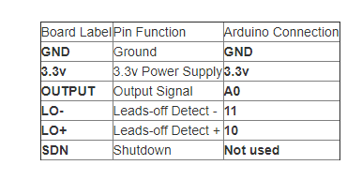
CIRCUIT
The pin connections between the AD8232 and Arduino UNO are shown .
8

Slide 9

Components:
ARDUINO UNO:
PINS:
Digital I/O Pins (0–13): Used for digital input/output operations, pins 0 and 1 are also for serial communication.
Analog Input Pins (A0–A5): Read analog signals (0–5V) and convert them to digital values (10-bit resolution).
Power and Special Pins: Include 3.3V, 5V, GND, VIN, Reset, and PWM-capable pins like 3, 5, 6, 9, 10, 11.

Slide 10
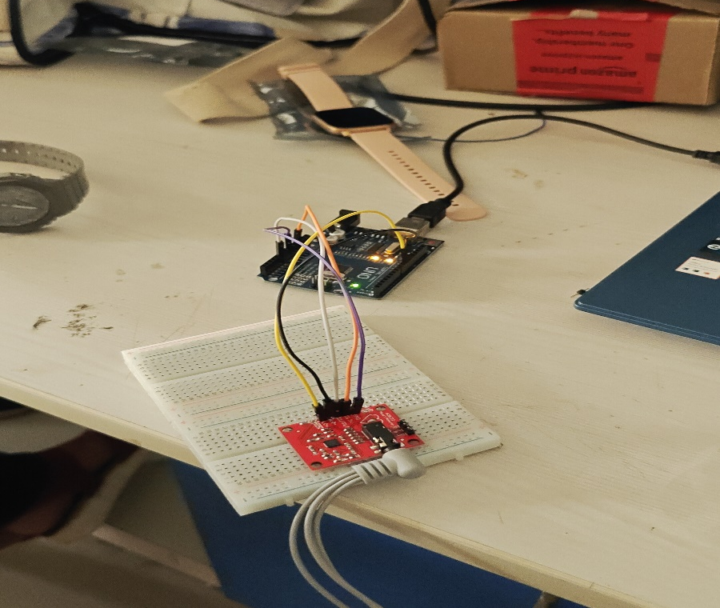
Working
Connect AD8232 to Arduino Uno properly Link OUTPUT to A0, VCC to 3.3V/5V, and GND for accurate ECG signal input.
Upload code via Arduino IDE and power the board Read analog ECG data using analogRead, then power Arduino through USB or power bank.
Display ECG waveform using Serial Plotter Monitor real-time ECG signals on the Serial Plotter and ensure clean, noise-free output.

Slide 11
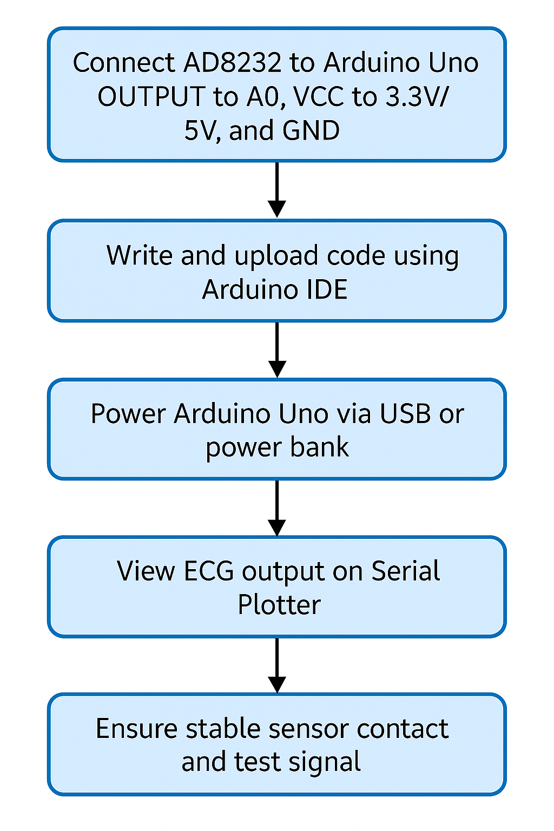
Flowchart of the program
11

Slide 12
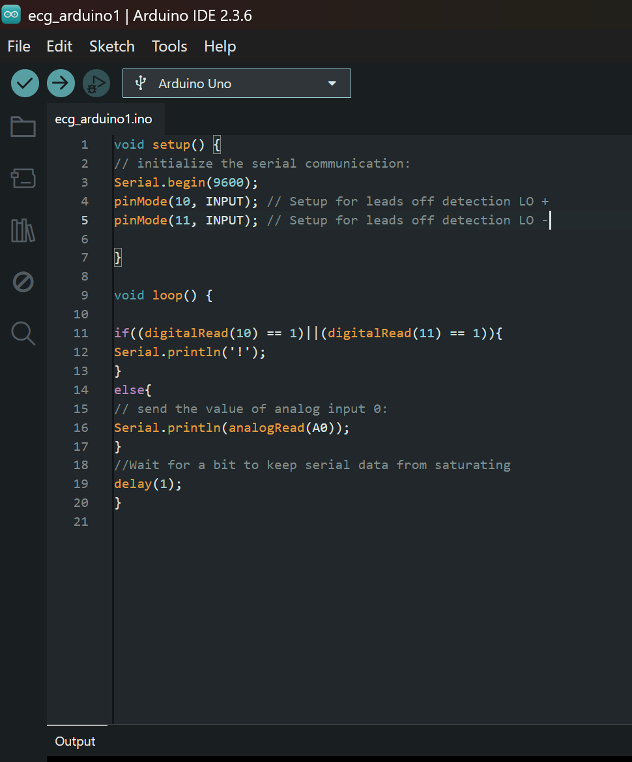
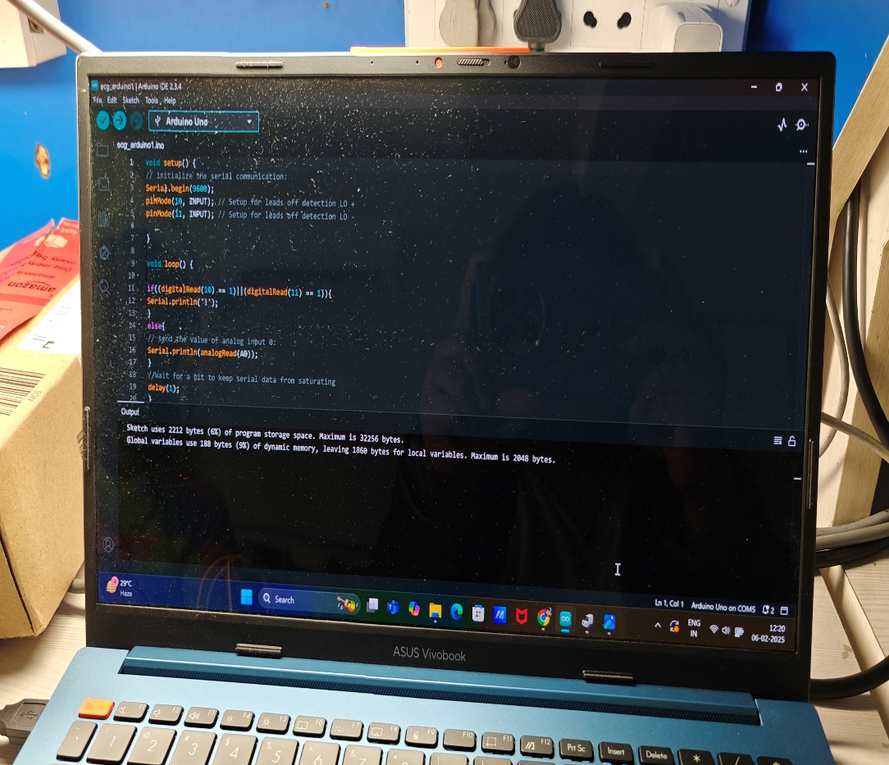
Arduino IDE Source Code/Program

Slide 13
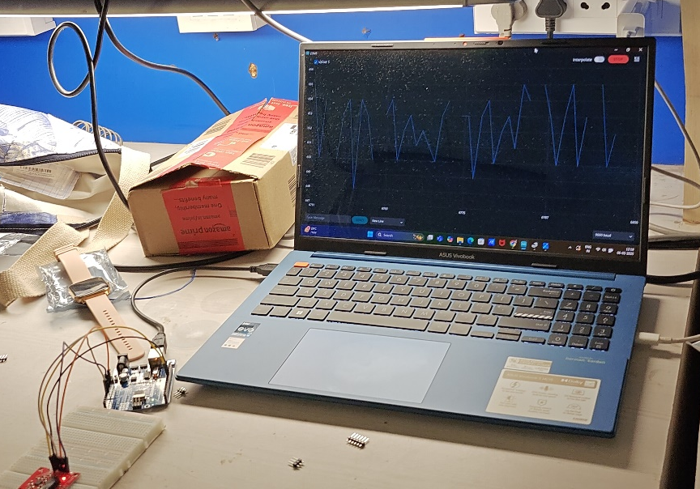
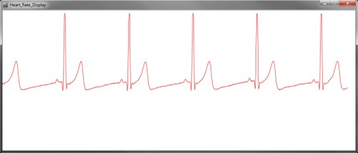
Result:
Once the code is uploaded, you can see the value on serial monitor and also on the serial plotter.

Slide 14
Implementation with ESP32(Wireless Version)
In this implementation we use esp32 & Ubidots platform to provide our ECG device with wireless capabilities
ESP32 provides wireless capabilities like Wi-Fi and Bluetooth needed for remote monitoring.
Ubidots platform provides an environment to monitor our ECG data remotely.
All other components remain same.

Slide 15
Components
ESP32(1)
AD8232 ECG Sensor(1)
ECG Electrodes(3)
Type B Cable(1)
Connecting Wires(More than one)
Breadboard(1)
Arduino IDE
Ubidots (Or any other IoT Platform)

Slide 16
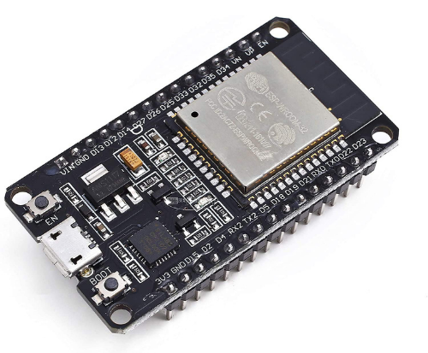
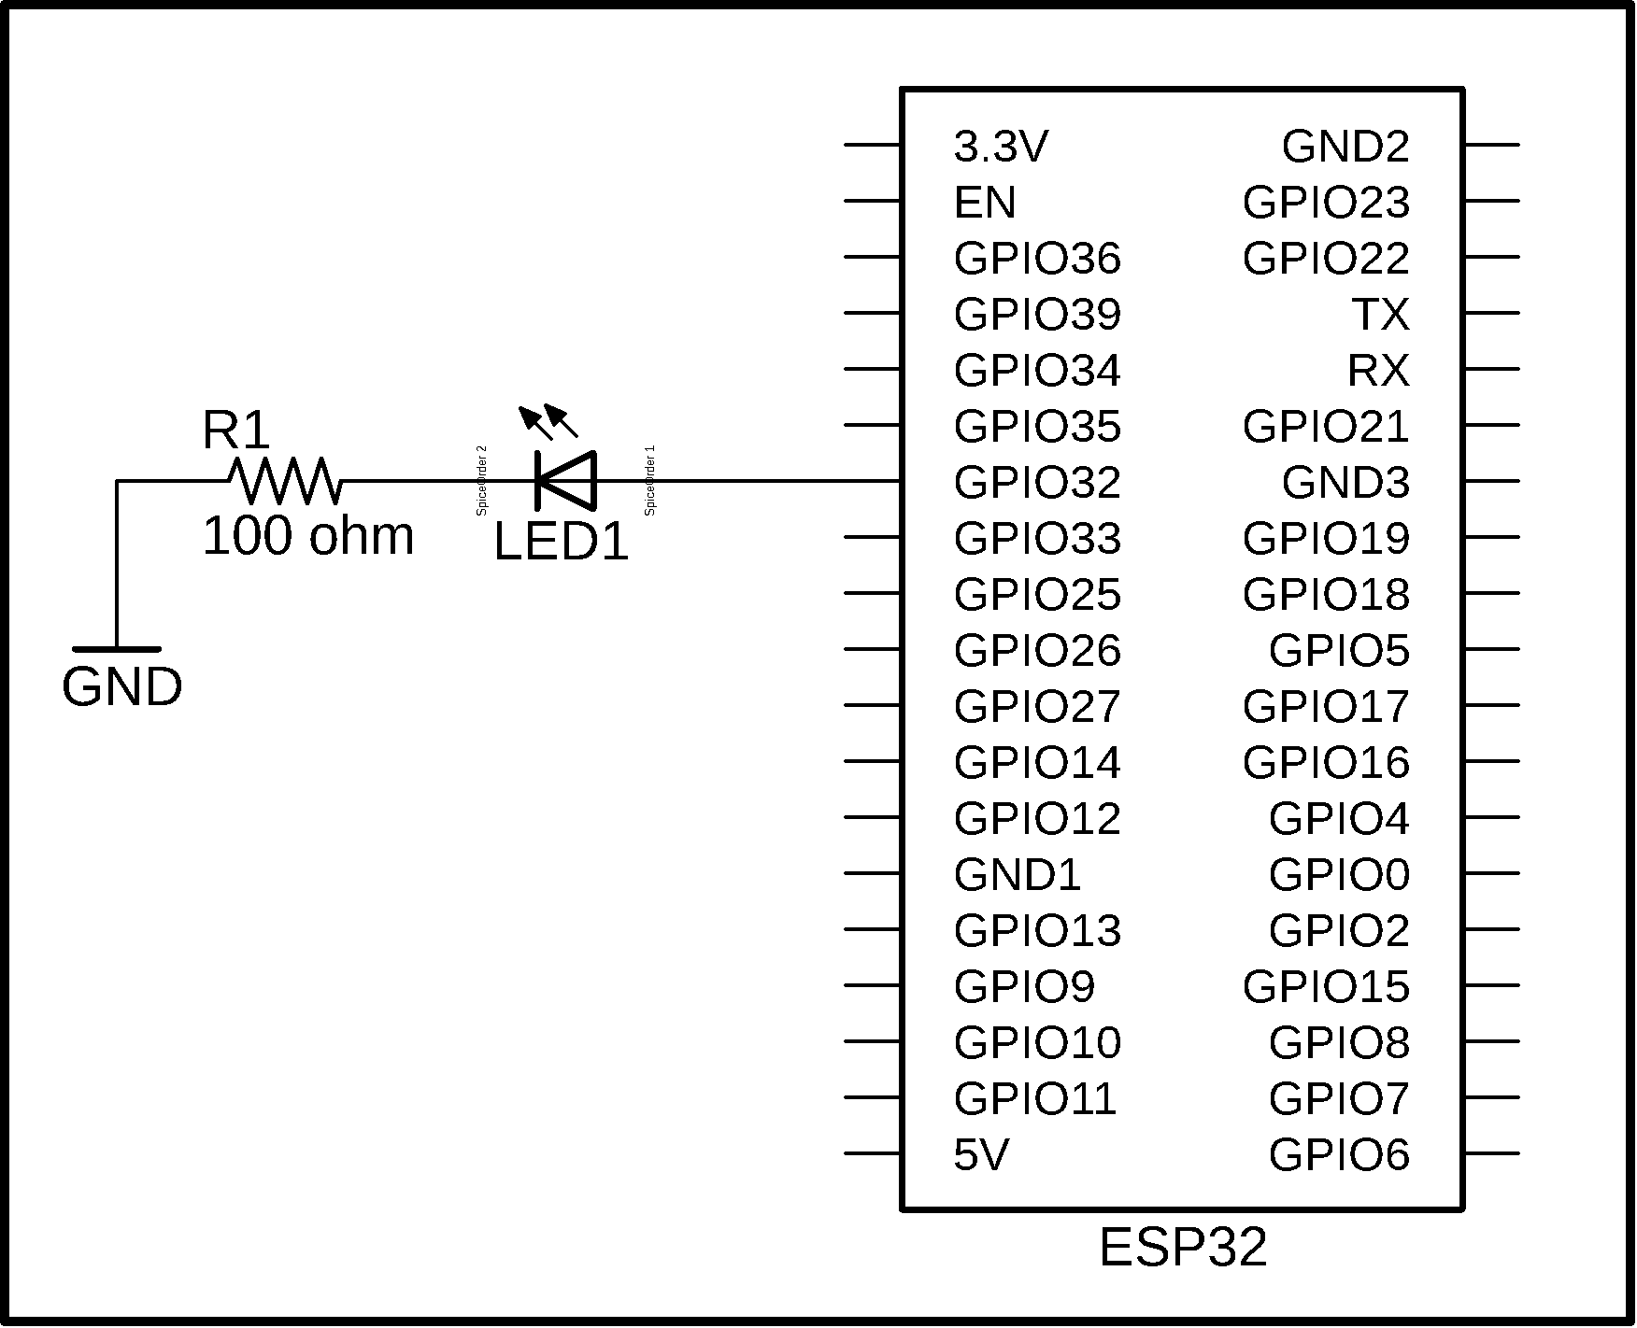
ESP32
PINS
GPIO Pins: The ESP32 has 34 GPIO pins, which are versatile and can be used for digital input, output, PWM, and more.
Analog Pins: It offers up to 18 analog input pins (ADC), allowing the measurement of analog signals with a 12-bit resolution.
Special Function Pins: Certain pins support specific functions like SPI, I2C, UART, and DAC, enabling flexible communication with peripherals.

Slide 17
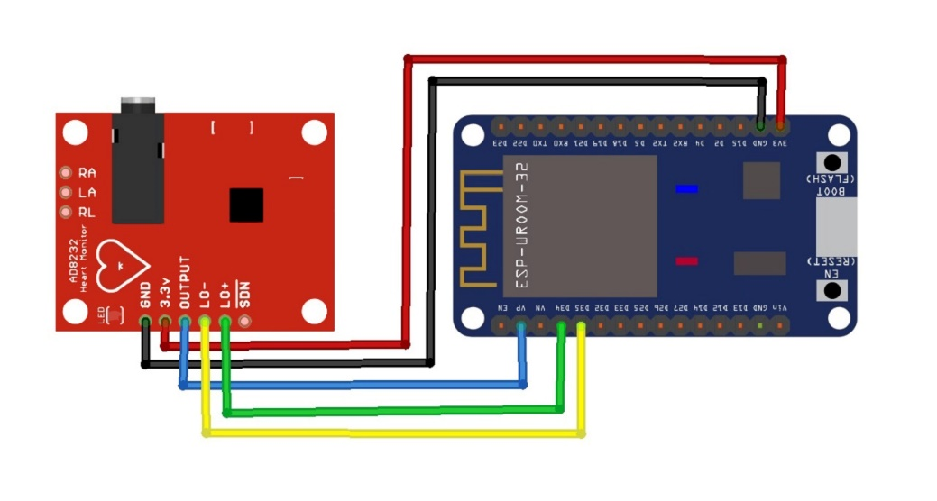
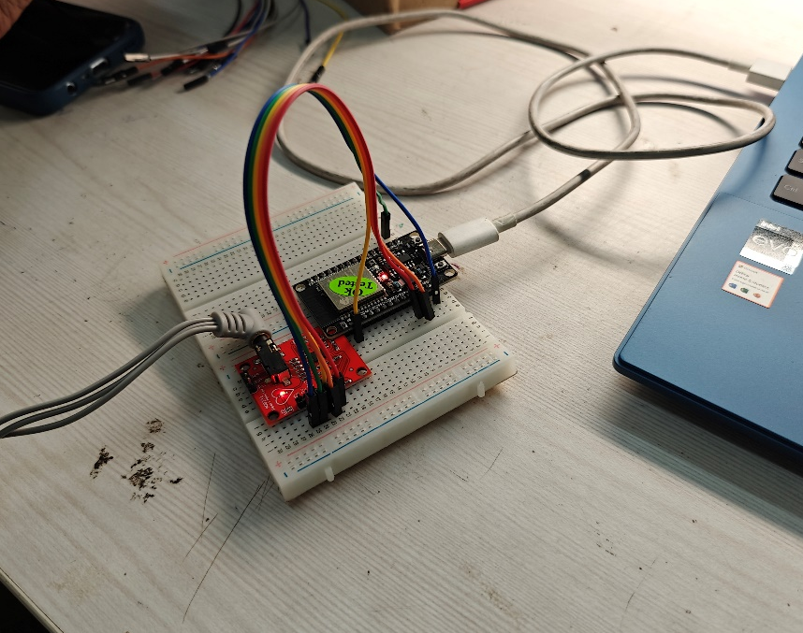
CIRCUIT
AD8232 Pin | ESP32 Pin
GND | GND
3.3V | 3.3V
OUTPUT | GPIO36
LO+ | GPIO14 (Optional)
LO- | GPIO12 (Optional)
IN+ | ECG electrode (positive lead)
IN- | ECG electrode (negative lead)

Slide 18
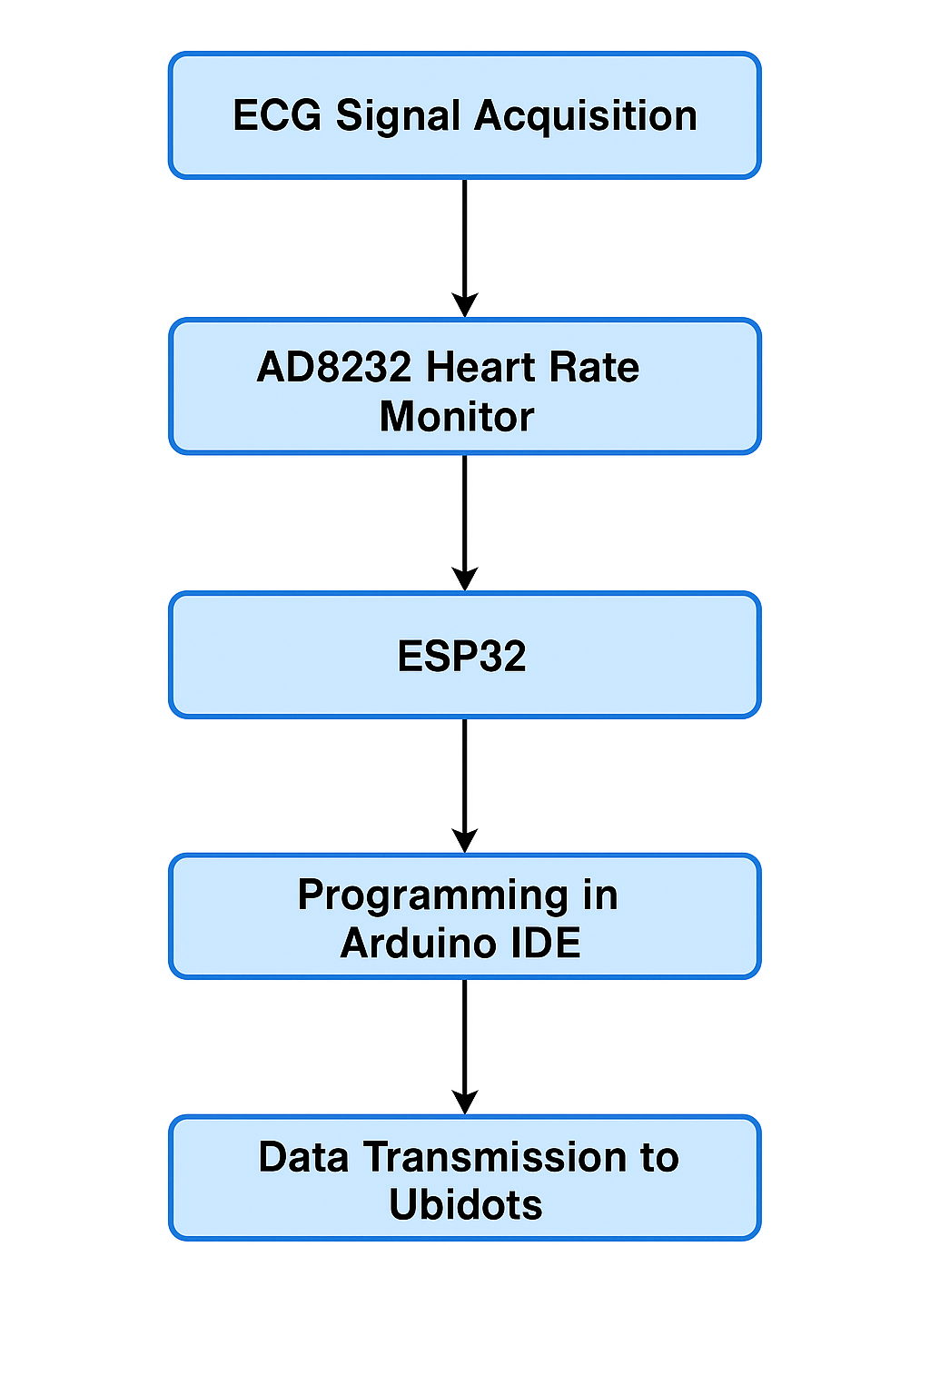
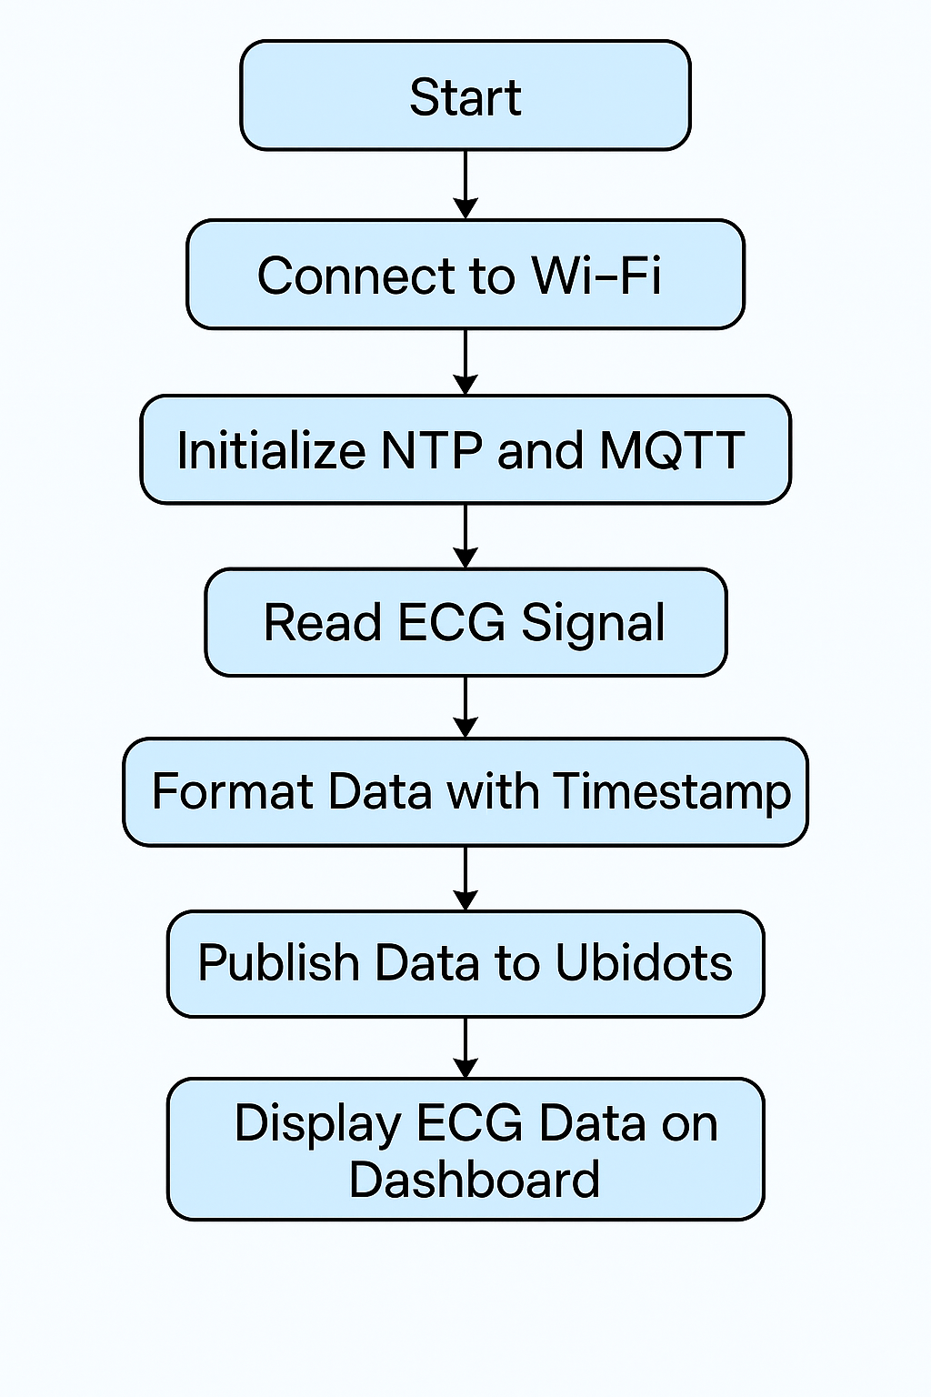
Flowchart

Slide 19
Code
WiFi and MQTT Setup The code connects the ESP32 to a WiFi network and sets up MQTT to communicate with the Ubidots IoT cloud platform.
ECG Data Reading and Timestamping It reads analog ECG data from the AD8232 sensor and uses NTP to add accurate timestamps to each reading.
Payload Formatting and Publishing ECG data is formatted into a JSON payload and published to Ubidots using the MQTT protocol for cloud visualization and analysis.
Auto-Reconnect and Serial Output Includes functions to auto-reconnect if WiFi or MQTT disconnects and prints debug info to the Serial Monitor for troubleshooting.

Slide 20
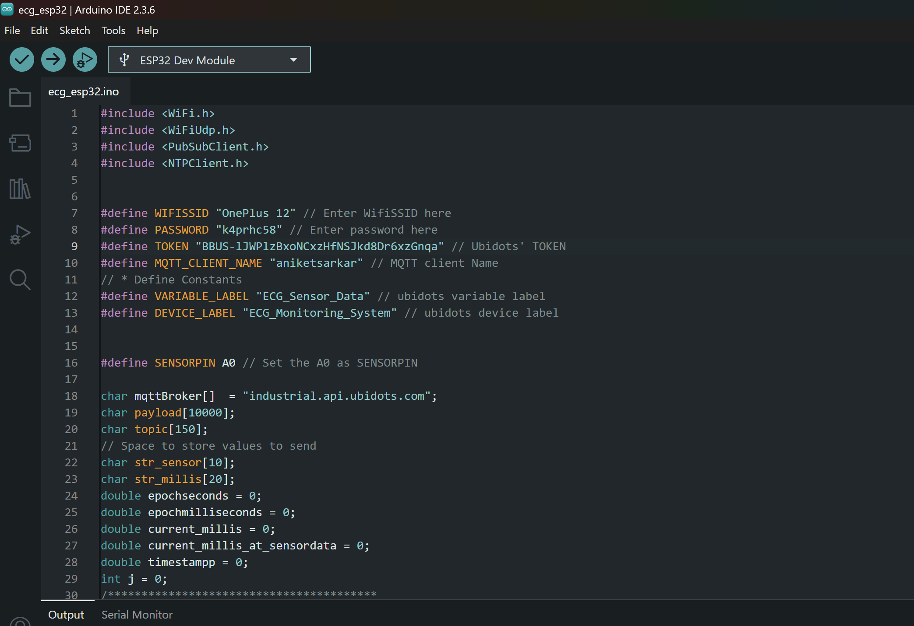
SOURCE CODE:

Slide 21
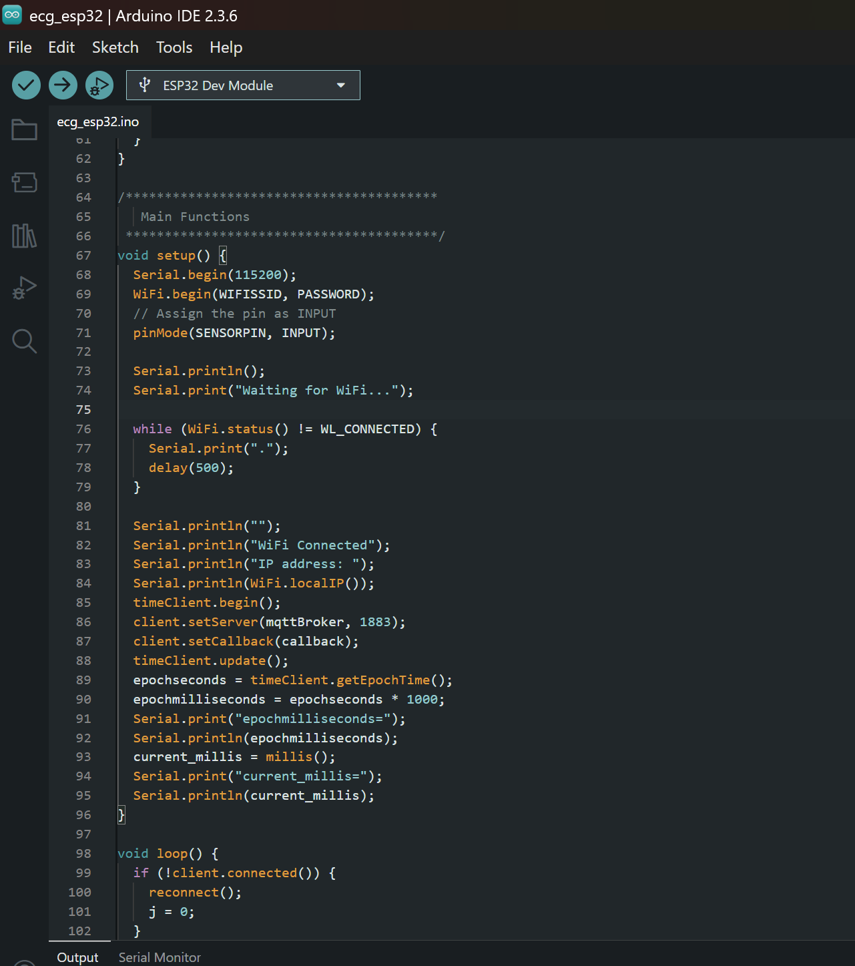

Slide 22
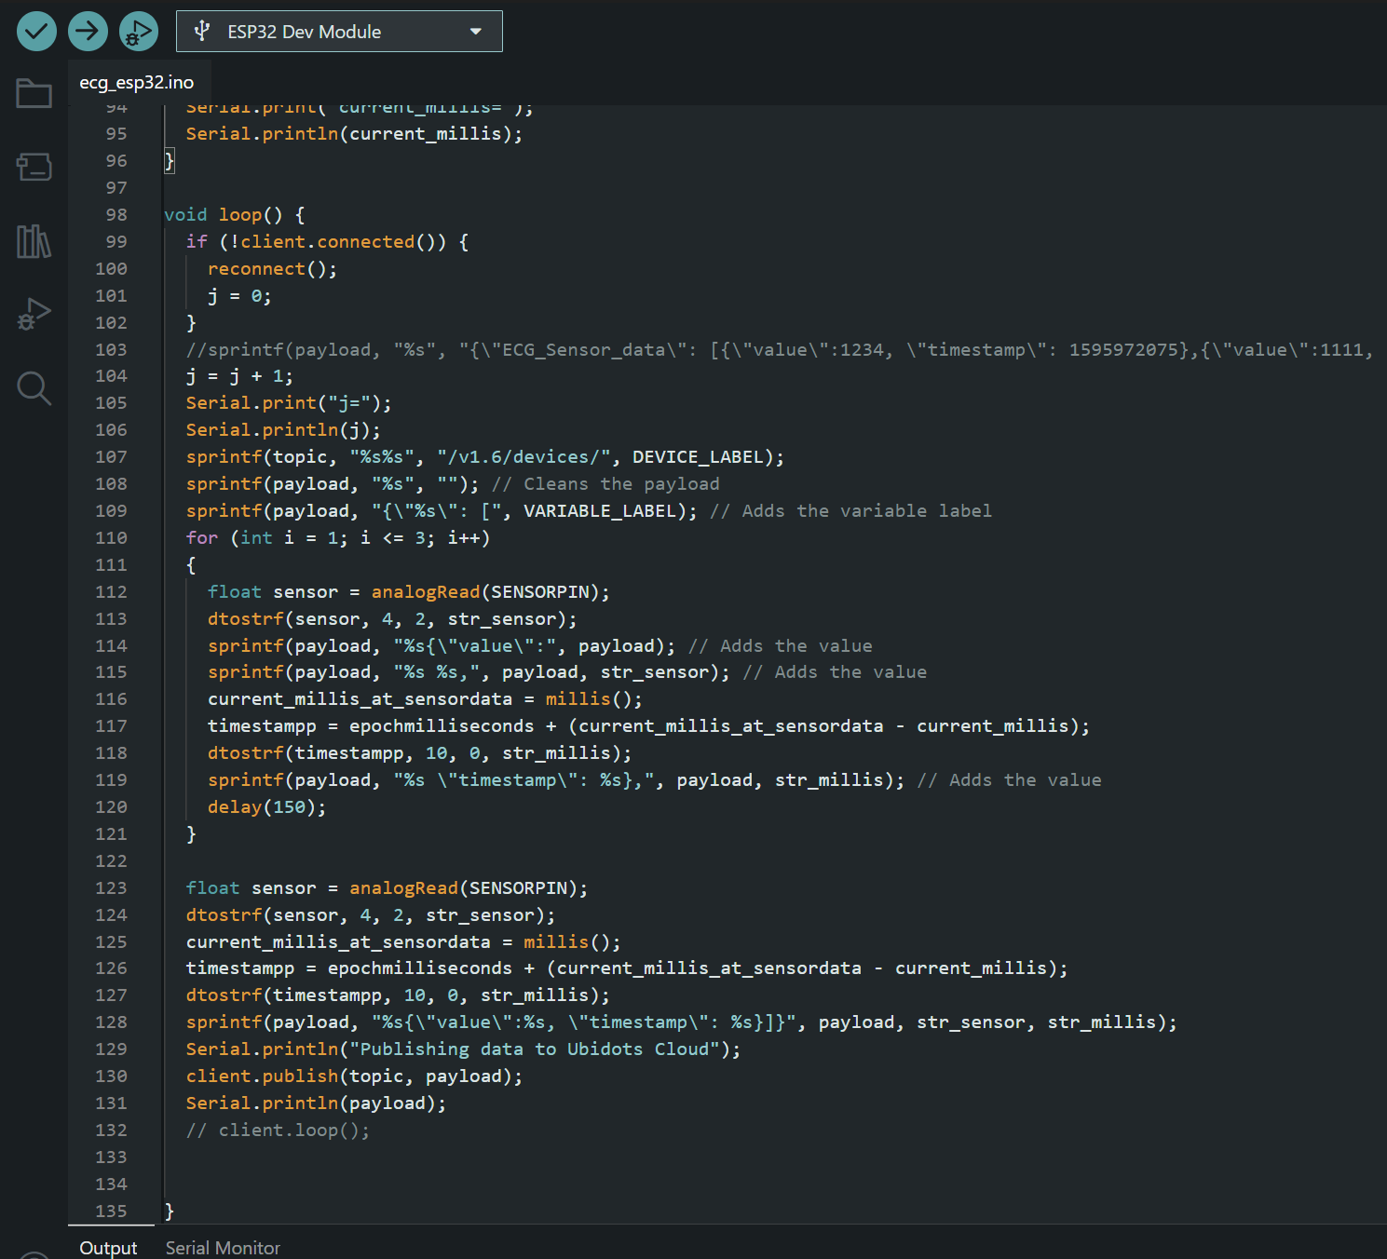

Slide 23
Most important part of code
for (int i = 1; i <= 3; i++) {
float sensor = analogRead(SENSORPIN);
dtostrf(sensor, 4, 2, str_sensor);
current_millis_at_sensordata = millis();
timestampp = epochmilliseconds + (current_millis_at_sensordata - current_millis);
dtostrf(timestampp, 10, 0, str_millis);
sprintf(payload, "%s{\"value\": %s, \"timestamp\": %s},", payload, str_sensor, str_millis);
delay(150);
}
1. Sensor Data Collection
It reads real-time ECG data from the AD8232 sensor using analogRead().
2. Timestamping
Assigns each ECG value a precise real-world timestamp using NTP time + millis() offset.
This ensures the data is chronologically accurate, which is critical in biomedical applications.
3. Data Formatting
It builds the JSON payload that Ubidots requires for time-series data visualization and analysis.
4. Sampling Rate Control
Uses delay(150) to space out readings (approx. 6–7 Hz), simulating a basic ECG sample rate.

Slide 24
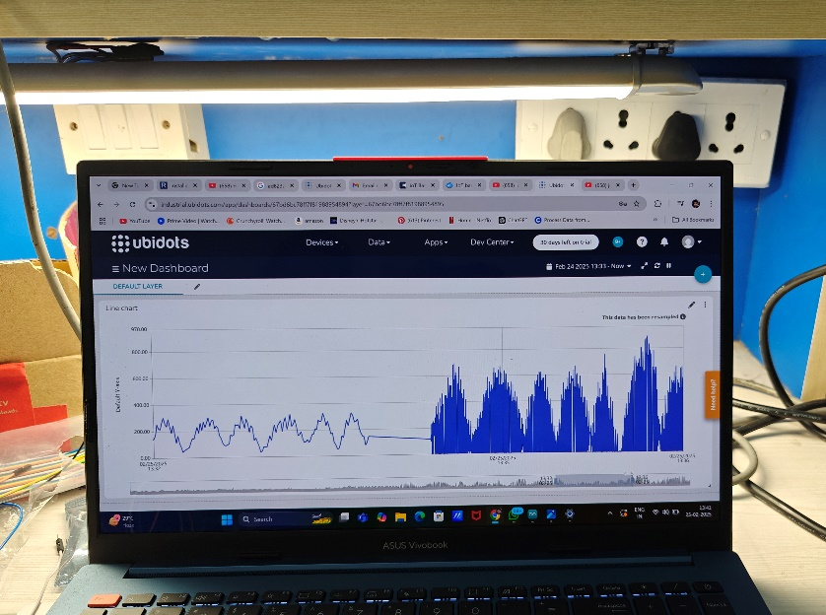
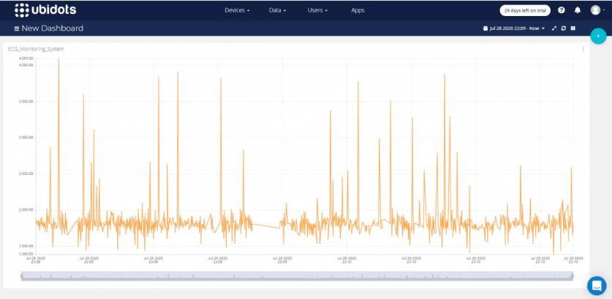
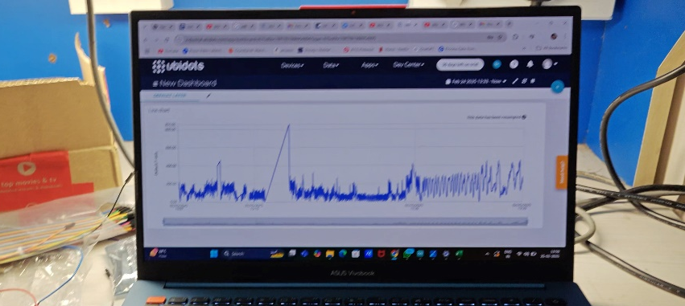
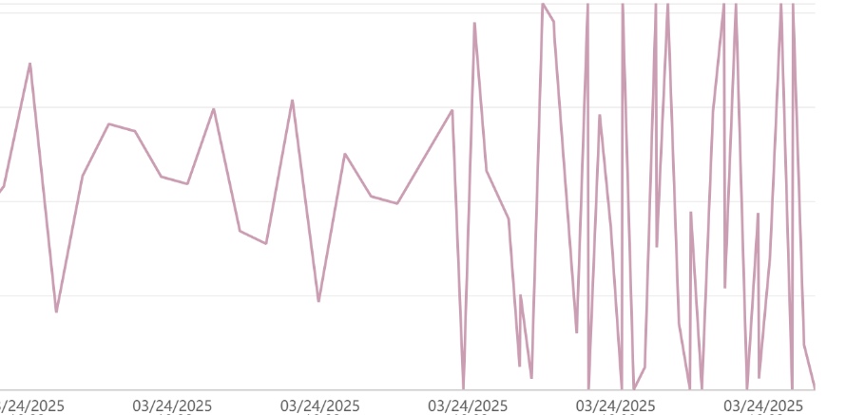
RESULTS:
We upload the connect the esp32 to the Ubidots Platform and view the results

Slide 25
References
[1] Wikipedia contributors, “ESP32,” Wikipedia, https://en.wikipedia.org/wiki/ESP32 (accessed May 4, 2025).
[2] Wikipedia contributors, “Arduino Uno,” Wikipedia, https://en.wikipedia.org/wiki/Arduino_Uno (accessed May 4, 2025).
[3] Wikipedia contributors, “AD8232,” Wikipedia, https://en.wikipedia.org/wiki/AD8232 (accessed May 4, 2025).
[4] How2Electronics, “ECG Graph Monitoring with AD8232 ECG Sensor & ESP32 on Ubidots,” How2Electronics, [Online]. Available: https://how2electronics.com/ecg-monitoring-ad8232-esp32-ubidots-cloud/ (accessed May 4, 2025).
[5] Electronics Innovation, “AD8232 ECG Module with Arduino,” Electronics Innovation, [Online]. Available: https://electronicsinnovation.com/interfacing-ad8232-ecg-module-with-arduino/ (accessed May 4, 2025).
[6] Ubidots Help Center, “Getting Started with Ubidots MQTT API,” Ubidots, [Online]. Available: https://help.ubidots.com/en/articles/1979518-getting-started-with-the-ubidots-mqtt-api (accessed May 4, 2025).
[7] Espressif Systems, ESP32 Technical Reference Manual, [Online]. Available: https://www.espressif.com/sites/default/files/documentation/esp32_technical_reference_manual_en.pdf (accessed May 4, 2025).
[8] M. Mahfouz and Y. Zhang, “Wireless ECG Monitoring Systems: A Review,” Journal of Healthcare Engineering, vol. 5, no. 3, pp. 203–228, 2014.
[9] Ubidots, “ESP32 MQTT Example Code,” GitHub, [Online]. Available: https://github.com/ubidots/ubidots-mqtt-esp (accessed May 4, 2025).
[10] Analog Devices Inc., AD8232: Heart Rate Monitor Front End Datasheet, [Online]. Available: https://www.analog.com/media/en/technical-documentation/data-sheets/ad8232.pdf (accessed May 4, 2025).
[11] F. Akhter and F. Ahmed, “IoT-Based Health Monitoring Systems for Remote Patient Care,” in IoT Applications for Healthcare Systems, IGI Global, 2020.

